Slide 1
Service Mesh v1
input config
Manager
(API, CLI, web portal)
Mixer
(adapters for backend)
Auth
configuration data to proxy
ssl cert
Control Plane
- Provides policy and configuration for all of the running data planes in the mesh.
Data Plane
- Touches every packet/request in the system.
service discovery & registration
health checking
routing (http proxying)
load balancing
authentication and authorization
observability(distributed tracing, logging, and metrics)
traffic split (label, version based, content based)
rate limiter
circuit breaker
consul agent
statsd
spiped
logstash
customized API library
rate limeter based on redis
Pod
Pod
Sidecar Proxy
Sidecar Proxy
HTTP/1.1,HTTP/2
TCP w/ or w/o TLS
appA
appB
Service A
Service B

Slide 2
Service Mesh v1
input config
Manager
(API, CLI, web portal)
Mixer
(adapters for backend)
Auth
configuration data to proxy
ssl cert
Control Plane
- Provides policy and configuration for all of the running data planes in the mesh.
Data Plane
- Touches every packet/request in the system.
service discovery & registration
health checking
routing (http proxying)
load balancing
authentication and authorization
observability(distributed tracing, logging, and metrics)
traffic split (label, version based, content based)
rate limiter
circuit breaker
consul agent
statsd
spiped
logstash
customized API library
rate limeter based on redis
Pod
Pod
Sidecar Proxy
Sidecar Proxy
HTTP/1.1,HTTP/2
TCP w/ or w/o TLS
appA
appB
Service A
Service B

Slide 3
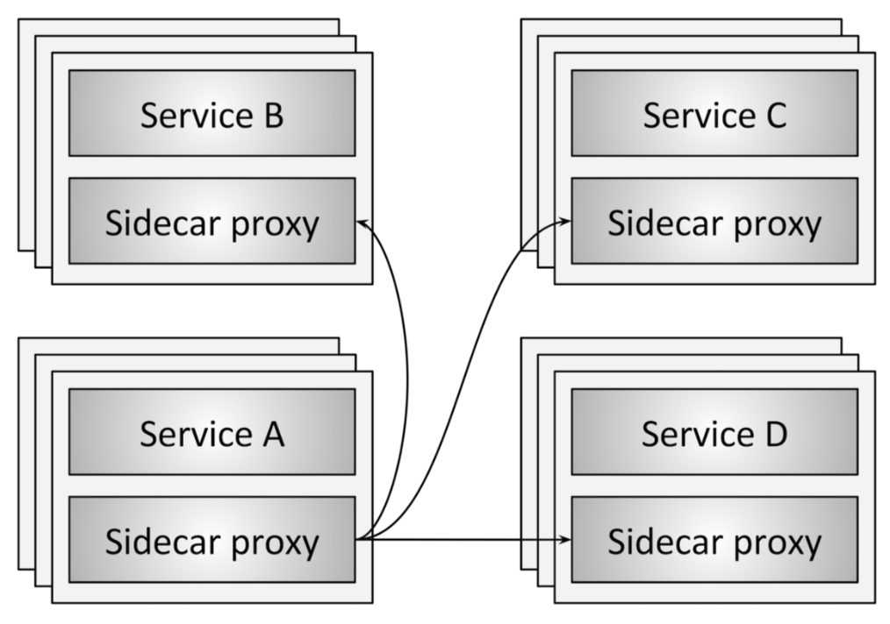
Service discovery
Health checking
Routing
Load balancing
Authentication and authorization
Observability(distributed tracing, logging, and metrics)
Notes:
Service discovery: What are all of the upstream/backend service instances that are available?
Health checking: Are the upstream service instances returned by service discovery healthy and ready to accept network traffic? This may include both active (e.g., out-of-band pings to a /healthcheck endpoint) and passive (e.g., using 3 consecutive 5xx as an indication of an unhealthy state) health checking.
Routing: Given a REST request for /foo from the local service instance, to which upstream service cluster should the request be sent?
Load balancing: Once an upstream service cluster has been selected during routing, to which upstream service instance should the request be sent? With what timeout? With what circuit breaking settings? If the request fails should it be retried?
Authentication and authorization: For incoming requests, can the caller be cryptographically attested using mTLS or some other mechanism? If attested, is the caller allowed to invoke the requested endpoint or should an unauthenticated response be returned?
Observability: For each request, detailed statistics, logging, and distributed tracing data should be generated so that operators can understand distributed traffic flow and debug problems as they occur.

Slide 4
Data plane vs. control plane summary
Service mesh data plane: Touches every packet/request in the system. Responsible for service discovery, health checking, routing, load balancing, authentication/authorization, and observability.
Service mesh control plane: Provides policy and configuration for all of the running data planes in the mesh. Does not touch any packets/requests in the system. The control plane turns all of the data planes into a distributed system.
Notes:
The human: There is still a (hopefully less grumpy) human in the loop making high level decisions about the overall system.
Control plane UI: The human interacts with some type of UI to control the system. This might be a web portal, a CLI, or some other interface. Through the UI, the operator has access to global system configuration settings such as deploy control (blue/green and/or traffic shifting), authentication and authorization settings, route table specification (e.g., when service A requests /foo what happens), and load balancer settings (e.g., timeouts, retries, circuit breakers, etc.).
Workload scheduler: Services are run on an infrastructure via some type of scheduling system (e.g., Kubernetes or Nomad). The scheduler is responsible for bootstrapping a service along with its sidecar proxy.
Service discovery: As the scheduler starts and stops service instances it reports liveness state into a service discovery system.
Sidecar proxy configuration APIs: The sidecar proxies dynamically fetch state from various system components in an eventually consistent way without operator involvement. The entire system composed of all currently running service instances and sidecar proxies eventually converge. Envoy’s universal data plane API is one such example of how this works in practice.

Slide 5
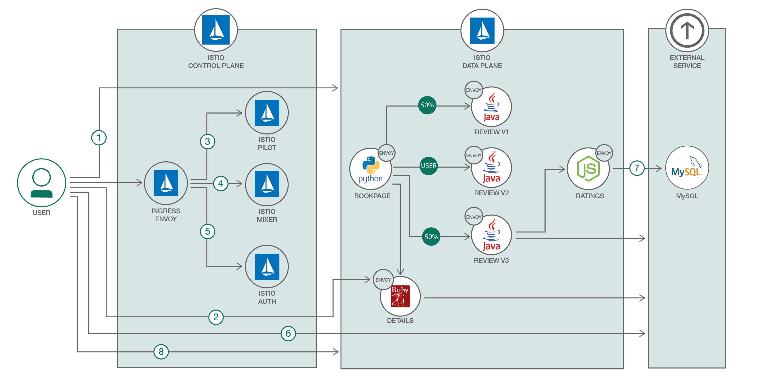

Slide 6
Istio Architecture
Proxy
Control Plane REST API
Istio ingress
Controller
Prometheus
Istio Control Plane
Metrics & reports from proxies
Istio Control Plane
Istio Control Plane
(Manager, Mixer)
User/application traffic. HTTP/1.1, HTTP/2, gRPC, TCP with or without TLS
Kube API Server
Istio control plane traffic. Request routing rules, resilience configuration (circuit breakers, timeouts, retries), policies (ACLs, rate limits, auth), and metrics/reports from proxies.
2. Proxy implements intelligent L7 routing, circuit breakers, enforces policies and reports metrics to control plane.
Pod
Proxy
Proxy
Proxy. Based on Envoy, a high performance L7 proxy from Lyft, currently being used at large scale in production.
https://github.com/lyft/envoy
1. All traffic entering and leaving pod is transparently routed via Proxy without requiring any application changes.
appA
appB
Service A
Service B
Kubernetes Cluster

Slide 7
Istio Architecture
Manager - configures Istio deployments and propagate configuration to the other components of the system
Mixer - responsible for policy decisions and aggregating telemetry data from the other components in the system using a flexible plugin architecture
Proxy – (based on Envoy) mediates inbound and outbound traffic for all Istio-managed services. It enforces access control and usage policies, and provides rich routing, load balancing, and protocol conversion.
https://github.com/istio/istio/blob/master/ARCHITECTURE.md

